Slide 1
Logic Programming in Commercial Games: Experiences and Lessons Learned
Robert Zubek, SomaSim LLC, robert@somasim.com
Ian Horswill, Northwestern University, ian@northwestern.edu
Slides, software, and interactive demo: https://tinyurl.com/game-lp

Slide 2
What we’re going to talk about
What is logic programming?
LP in three commercial games
◦ Asset consistency checking
◦ Social graph queries
◦ Procedural generation
Experimental work
Software, slides, discord, and interactive demo: https://tinyurl.com/game-lp

Slide 3
What is logic programming?
◦ Logic
◦ Declarative programming
◦ A more declarative language than C++/C#/etc.
◦ Tell the system what you want
◦ It decides how to do it
◦ Programming language based on predicates/relations and rules, rather than functions
Notes:
There’s a lot of hyperbole surrounding logic programming
It’s not really logic and not fully declarative
But it’s closer to the ideal of telling the system what you want and having it decide how to do it
It does that by basing programs on predicates and rules rather than functions

Slide 4
Traditional languages
Basic unit is the function/method/procedure
z = f(x,y)
Unidirectional
Distinguish input(s) from output
Always ask “here are all the inputs, what’s the output?”
Reversing is hard
Work is done by chaining calls
Notes:
You know what functions are
The take inputs and give you an output
You can’t reverse them

Slide 5
Predicates (aka relations)
Generalization of functions
F(x,y,z) means z=f(x,y)
Don’t prejudice what things are inputs or outputs
You can set x and y and solve for z
Or set y and z and solve for x
Set all of them and just test if it’s true
Set none of them and ask for a data point
Notes:
Predicates are generalizations of functions
They express a relationship between their arguments
Without committing to which arguments are inputs and which are outputs
You can specify the arguments you know
And solve for the ones you don’t

Slide 6
Rules
A[x,y] if B[x,z], C[y,z]
“For any x,y,z, A[x,y] is true if B[x,z] and C[y,z] are true”
Most predicates are specified by rules
Notes:
Most predicates in logic programming are defined by rules
Rules say “this relationship is true, if those relationships are also true”

Slide 7
Example
Pet[x].If(Cat[x])
Pet[x].If(Dog[x])
Pet[x].If(Tiger[x], Tame[x])
“x is a pet if it’s a cat, dog, or tame tiger”
Query: Pet[chris] “is Chris a pet?”
Chris a pet if …
They’re a cat
Or they’re a dog
Or they’re a tiger …
◦ … and also tame
Notes:
For example, we want to define what a pet is
We can tell it
Cats are pets
Dogs are pets
Tigers are pets if they’re tame
That’s enough for the system to answer questions like “is chris a pet?”

Slide 8
Example
Pet[x].If(Cat[x])
Pet[x].If(Dog[x])
Pet[x].If(Tiger[x], Tame[x])
“x is a pet if it’s a cat, dog, or tame tiger”
So in C#, this is like:
bool Pet(Mammal x)
=> Cat(x) || Dog(x)
|| (Tiger(x) && Tame(x))
Notes:
So then it’s acting like a Boolean function in C#

Slide 9
Example
Pet[x].If(Cat[x])
Pet[x].If(Dog[x])
Pet[x].If(Tiger[x], Tame[x])
“x is a pet if it’s a cat, dog, or tame tiger”
Query: Pet[x] “find me a pet, x”
Set x to …
A cat, if you can find one
Otherwise, a dog
Otherwise, a tiger
◦ But check if it’s tame ◦ If not, try the next tiger
Notes:
But you can also pass it a special kind of argument called a logic variable
And the system will solve for the value of the logic variable
So we’re asking it to find a pet

Slide 10
Example
Pet[x].If(Cat[x])
Pet[x].If(Dog[x])
Pet[x].If(Tiger[x], Tame[x])
“x is a pet if it’s a cat, dog, or tame tiger”
So in C#, this is like:
Mammal? FindPet()
{ Mammal? result = FindCat(); if (result == null) result = FindDog(); if (result == null) foreach (var x in AllTigers) if (IsTame(x)) { result = x; break; }
return result;
}
Notes:
Now the predicate is acting like a different C# function
that’s more complicated
and has a completely different type signature

Slide 11
Example
Pet[x].If(Cat[x])
Pet[x].If(Dog[x])
Pet[x].If(Tiger[x], Tame[x])
“x is a pet if it’s a cat, dog, or tame tiger”
Query: Pet[x].SolveForAll(x) “find me all pets”
List all the cats
Then all the dogs
Then, for each tiger
◦ Check if it’s tame
◦ If so, it’s a pet
Notes:
We can also ask it to solve for all possible values of the variable
Find me all the pets

Slide 12
Example
Pet[x].If(Cat[x])
Pet[x].If(Dog[x])
Pet[x].If(Tiger[x], Tame[x])
“x is a pet if it’s a cat, dog, or tame tiger”
So in C#, this is like:
IEnumerable<Mammal> FindPets()
=> FindCats().Cast<Mammal>()
.Concat(FindDogs()).Cast<Mammal>()
.Concat(FindTigers.Where( t => t.IsTame) .Cast<Mammal>);
Notes:
Again, we can do this with a standard language
But it’s yet another piece of code
With yet another type signature
That we have to write and debug
And maintain if we change our data layout.

Slide 13
Example
Pet[x].If(Cat[x])
Pet[x].If(Dog[x])
Pet[x].If(Tiger[x], Tame[x])
“x is a pet if it’s a cat, dog, or tame tiger”
Query: Pet[x], Owner[x, rob] “find me Rob’s pet, x”
Go through the pets, one by one (see Pet[x] previous)
Check their owners
Until you find Rob’s pet (I’m guessing a tiger)
Notes:
Having defined our predicate
We can use it in more complicated rules and queries
For example, if we want to find not just any pet, but Rob’s pet
Find an x that is both a pet and owned by rob
And the system will iterate through the pets
First iterating through cats, then dogs, etc.
And test each one to see if it’s Rob’s

Slide 14
Example
Pet[x].If(Cat[x])
Pet[x].If(Dog[x])
Pet[x].If(Tiger[x], Tame[x])
“x is a pet if it’s a cat, dog, or tame tiger”
Query: Owner[x, rob], Pet[x] “find me Rob’s pet, x”
Go through Rob’s stuff, item by item
Check if each is a pet (see Pet[chris] example)
Notes:
Or if we reversed the order of the predicates
It will iterate through Rob’s possessions
Checking each to see if it’s a pet.

Slide 15
One rule is worth many functions
Rules stand in for many different algorithms. The system chooses between them at run-time based on context
Notes:
So by defining our system in terms of rules and predicates
We can make one piece of code serve many uses

Slide 16
TELL: Typed, Embedded, Logic language (github.com/ianhorswill/TELL)
Pet[x].If(Cat[x]);
Pet[x].If(Dog[x]);
Pet[x].If(Tiger[x], Tame[x]);
“x is a pet if it’s a cat, dog, or tame tiger”
Simple logic program subset
Embedded in C#
◦ TELL code is C# code
◦ Mix-and-match w/C#
Live coding support
MIT license
NB: Not highly optimized
Cheap and easy to experiment with
Notes:
By the way, the logic programming code we showed you is actually C#
It’s written in TELL
a simplified logic programming language
Embedded in C#
Meaning that TELL code is just C# code calling into the TELL DLL
It supports both compiled and interactive queries
So you can use it as a debugging tool in-engine
It’s free open source
And easy to drop into any unity or other C# project
So you can experiment without a big time investment

Slide 17
TELL predicates are C# objects
var Pet = Predicate("Pet", x); var Cat = Predicate("Cat", x); var Dog = Predicate("Dog", x); var Tiger = Predicate("Tiger", x); var Tame = Predicate("Tame", x);
… rules for your fur babies …
Pet[x].If(Cat[x]);
Pet[x].If(Dog[x]);
Pet[x].If(Tiger[x], Tame[x]);
if (Pet[chris]) DoSomething();
var aPet = Pet[x].SolveFor(x);
var lotsOfPets = Pet[x].SolveForAll(x);
Methods for
Adding rules
Calling ([ ] is overloaded)
Solving for variables
Notes:
It being embedded means that predicates are just C# objects
With methods for adding rules and calling them

Slide 18
TELL variables are C# objects
Mammal chris = …;
var x = (Var<Mammal>)"x"; var Pet = Predicate("Pet", x); var Cat = Predicate("Cat", x); var Dog = Predicate("Dog", x); var Tiger = Predicate("Tiger", x); var Tame = Predicate("Tame", x);
… rules for your fur babies …
Pet[x].If(Cat[x]);
Pet[x].If(Dog[x]);
Pet[x].If(Tiger[x], Tame[x]);
if (Pet[chris]) DoSomething();
Strongly typed (Var<int> vs. Var<Mammal>)
Just represent a variable name, not its value
Predicates are also strongly typed, based on variables passed in the constructor
Notes:
And logic variables are also just C# objects
Both logic variables and predicates are typed
So you get type-checking in your IDE

Slide 19
Predicates can access game state
var Owner = Predicate<Person,Mammal>( "Owner", person -> person.Stuff);
var Tame = Predicate<Mammal>("Tame", ModeDispatch( // Argument is input m => m.IsTame, // Argument is output () => Mammal.AllMammals .Where(m => m.IsTame)));
Eventually, you want your rules to access your game state
You do this with primitive predicates
You just tell it “run this C# code when this predicate is called”
Don’t have time to go into it in detail, though
Notes:
You can also write predicates that call directly into your native C# code

Slide 20
Reasons to use logic programming
Rules can be repurposed for many different uses
Easy to slap a query language on your game state (easier than SQL)
Some game logic is naturally described as rules anyway
Notes:
So logic programming is attractive because
You can write short pieces of code
that can be used flexibly for many different purposes
It’s relatively easy to add a query language to your native C# data structures
And a lot of AI tasks,
such as social reasoning
are naturally expressed as rules

Slide 21
Flavors of logic programming
Top-down (Prolog)
Start with a call to Pet, it tries each rule
First rule calls Cat, second calls Dog, third calls Tiger and Tame
Bottom-up (DATALOG)
Add all the cats to Pet, then all the dogs
Then the intersection of Tiger and Tame
SAT-based (ASP, SMT)
Use general constraint satisfaction algorithms
Notes:
What I’ve described here
Is classical, top-down logic programming
There are also other kinds
Which Rob will touch on
Which brings us to….

Slide 22
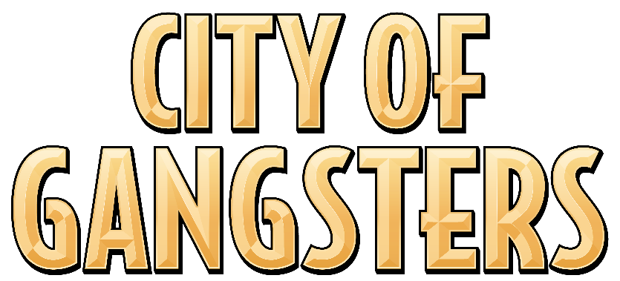
SomaSim

Slide 23
LP systems
Unity Prolog
BotL, CatSAT
(Future game)
TELL & TED, CatSAT

Slide 24
Project Highrise
Skyscraper simulator
Two AI experiments:
AI Planner for NPC behavior → see Game AI Pro 3 article
Prolog for asset consistency checking → Unity Prolog!

Slide 25
Consistency Checking
Example: we have tons of assets with cross-references xrefs use names and tags for flexibility
Problem: make sure all things are matched to each other
people
apts for rent
people
apts for rent
people
apts for rent
must
match
floorplans
floorplans
floorplans
jobs
offices
jobs
offices
jobs
offices

Slide 26
Consistency Checking
Matching residents with apartments for rent
Space tags (what they are): [ apartment, 1br, berlin ]
People tags (what they want): [ 1br, 2br, … ]
people
apts for rent
people
apts for rent
people
apts for rent
must
match

Slide 27
Consistency Checking
Verify that all tags are set up correctly:
all spaces have someone who could live there
all people have a space they want to live in
You could do this with tons of foreach loops…
MatchTags(S,P): for each tag T in tagsof(S) for each tag T’ in tagsof(P)
return true if T = T’
for each space S for each people P
signal a problem if MatchTags(S,P) != true

Slide 28
Consistency Checking
Verify that all tags are set up correctly:
all spaces have someone who could live there
all people have a space they want to live in
You could do this with tons of foreach loops, or… express it as a rule and let the computer validate it
Rule:
∀ S ∈ Spaces, P ∈ People
∃ T: T ∈ tagsof(S) ∧ T ∈ tagsof(P)
Signal a problem if false

Slide 29
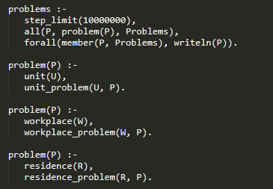
Prolog code
Iterates through all residence definitions,
all peoples’ move-in preferences,
all their respective tags,
and makes sure they match up

Slide 30
Prolog code
We ended up with 400 lines of Prolog
Most of it written in one afternoon

Slide 31
Takeaways
Tests were queries over tree-like data structures
Loved writing tests as queries, rather than imperatively
All tests could be localized in a central place
Unity Prolog
ISO Prolog – very powerful, but can be tricky
Need to understand how queries get executed (e.g. “cut”)
Our use cases didn’t exercise all that power

Slide 32
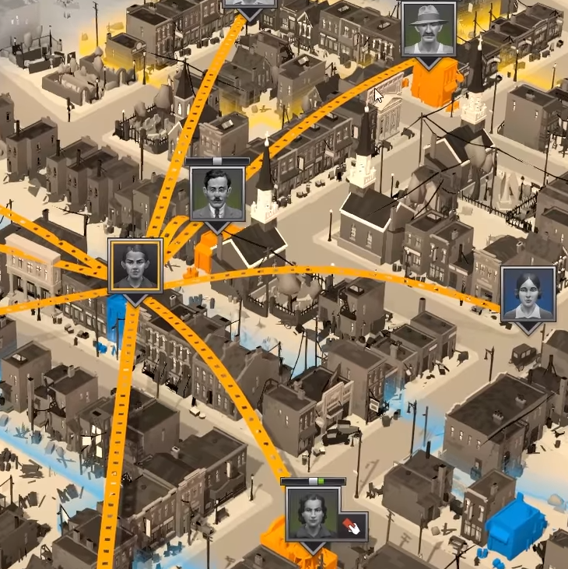
City of Gangsters
Prohibition-era organized crime sim
Full of secret deals and vendettas
AI task: querying over social graph at runtime

Slide 33
City of Gangsters
We wanted social effects like vendettas
“You killed my father, prepare to die”
Run a query over social graph:
Find X, Y, Z such that
X is the player
X killed Y
Y is Z’s relative
And modify Z’s relationship to X

Slide 34
City of Gangsters
Also, nice effects:
“You helped my friend, I appreciate that”
Run a query over social graph:
Find X, Y, Z such that
X is the player
X helped Y
Y is Z’s friend
And modify Z’s relationship to X

Slide 35
City of Gangsters
Or more generally, social norms:
“You [acted] on [someone’s] [relation], I have [reaction]”
Run a query over social graph:
Find X, Y, Z, A, R such that
X is the player
X performed action A with Y
Y and Z have relationship R
And modify Z’s relationship to X
Positive examples: help, complete quest, give money
Negative: extort, harm, kill

Slide 36
BotL, aka “Bot Language”
C# implementation, highly optimized for runtime performance
Stack allocated, no runtime mallocs
Custom VM: Vienna Abstract Machine 2P
Prolog feature set cut down to help with performance

Slide 37
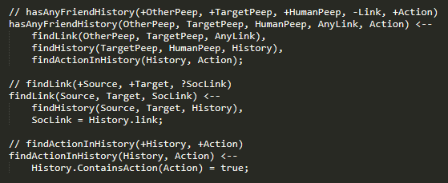
BotL code
Actual BotL code is not super readable :)
Let’s rephrase a bit…

Slide 38
Social inference in TELL (MicroCoG demo at https://tinyurl.com/game-lp)
var ReactionToAction = Predicate(action, target, reactor, reaction, buffTotal) .If(ReactionType[action, reaction, relationshipClass], RelationshipOf[target, rel], RelationshipClass[rel, relationshipClass], RelationshipType[rel, relationshipType], RelationshipTo[rel, reactor], Sum[buff, ReactionBuff[reaction, relationshipClass, relationshipType, buff], buffTotal]);

Slide 39
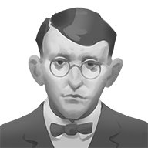
Social inference
knows
child-of
Player
Bob
Alice
Dave
action: violence
target: Bob

Slide 40
Social inference
If somebody does action to NPC target
var ReactionToAction = Predicate(action, target, reactor, reaction, buffTotal) .If(ReactionType[action, reaction, relationshipClass], RelationshipOf[target, rel], RelationshipClass[rel, relationshipClass], RelationshipType[rel, relationshipType], RelationshipTo[rel, reactor], Sum[buff, ReactionBuff[reaction, relationshipClass, relationshipType, buff], buffTotal]);

Slide 41
Social inference
Then NPC reactor will have reaction
var ReactionToAction = Predicate(action, target, reactor, reaction, buffTotal) .If(ReactionType[action, reaction, relationshipClass], RelationshipOf[target, rel], RelationshipClass[rel, relationshipClass], RelationshipType[rel, relationshipType], RelationshipTo[rel, reactor], Sum[buff, ReactionBuff[reaction, relationshipClass, relationshipType, buff], buffTotal]);

Slide 42
Social inference
And it will change
their trust by buffTotal
var ReactionToAction = Predicate(action, target, reactor, reaction, buffTotal) .If(ReactionType[action, reaction, relationshipClass], RelationshipOf[target, rel], RelationshipClass[rel, relationshipClass], RelationshipType[rel, relationshipType], RelationshipTo[rel, reactor], Sum[buff, ReactionBuff[reaction, relationshipClass, relationshipType, buff], buffTotal]);

Slide 43
Social inference
IF
var ReactionToAction = Predicate(action, target, reactor, reaction, buffTotal) .If(ReactionType[action, reaction, relationshipClass], RelationshipOf[target, rel], RelationshipClass[rel, relationshipClass], RelationshipType[rel, relationshipType], RelationshipTo[rel, reactor], Sum[buff, ReactionBuff[reaction, relationshipClass, relationshipType, buff], buffTotal]);

Slide 44
Social inference
Reaction is the kind
of reaction people
have to that action
var ReactionToAction = Predicate(action, target, reactor, reaction, buffTotal) .If(ReactionType[action, reaction, relationshipClass], RelationshipOf[target, rel], RelationshipClass[rel, relationshipClass], RelationshipType[rel, relationshipType], RelationshipTo[rel, reactor], Sum[buff, ReactionBuff[reaction, relationshipClass, relationshipType, buff], buffTotal]);

Slide 45
Social inference
Rel is someone in
in target’s network
of the right class
var ReactionToAction = Predicate(action, target, reactor, reaction, buffTotal) .If(ReactionType[action, reaction, relationshipClass], RelationshipOf[target, rel], RelationshipClass[rel, relationshipClass], RelationshipType[rel, relationshipType], RelationshipTo[rel, reactor], Sum[buff, ReactionBuff[reaction, relationshipClass, relationshipType, buff], buffTotal]);

Slide 46
Social inference
Rel is of this type (mother, acquaintance, …)
var ReactionToAction = Predicate(action, target, reactor, reaction, buffTotal) .If(ReactionType[action, reaction, relationshipClass], RelationshipOf[target, rel], RelationshipClass[rel, relationshipClass], RelationshipType[rel, relationshipType], RelationshipTo[rel, reactor], Sum[buff, ReactionBuff[reaction, relationshipClass, relationshipType, buff], buffTotal]);

Slide 47
Social inference
Rel is a relationship of the target to the reactor
var ReactionToAction = Predicate(action, target, reactor, reaction, buffTotal) .If(ReactionType[action, reaction, relationshipClass], RelationshipOf[target, rel], RelationshipClass[rel, relationshipClass], RelationshipType[rel, relationshipType], RelationshipTo[rel, reactor], Sum[buff, ReactionBuff[reaction, relationshipClass, relationshipType, buff], buffTotal]);

Slide 48
Social inference
And buffTotal is the sum of all the applicable buffs
var ReactionToAction = Predicate(action, target, reactor, reaction, buffTotal) .If(ReactionType[action, reaction, relationshipClass], RelationshipOf[target, rel], RelationshipClass[rel, relationshipClass], RelationshipType[rel, relationshipType], RelationshipTo[rel, reactor], Sum[buff, ReactionBuff[reaction, relationshipClass, relationshipType, buff], buffTotal]);

Slide 49
Social inference
var ReactionToAction = Predicate(action, target, reactor, reaction, buffTotal) .If(ReactionType[action, reaction, relationshipClass], RelationshipOf[target, rel], RelationshipClass[rel, relationshipClass], RelationshipType[rel, relationshipType], RelationshipTo[rel, reactor], Sum[buff, ReactionBuff[reaction, relationshipClass, relationshipType, buff], buffTotal]);

Slide 50
Social inference in TELL
knows
child-of
Player
Bob
Alice
action: violence
target: Bob
reactor: Alice
reaction: violence-reaction
relationshipClass: Family
relationshipType: Child
buff: -2
relationship buff: -2

Slide 51
Takeaways
Declarative queries are great
BotL is really, really fast
We wished for better debugging and embedding into C#
Idea: but what if we had LP that’s more like Linq than SQL?
Embedded in C# rather than external
Use strong typing and easy .NET interop
Benefit from Visual Studio debugger, IntelliSense, etc.

Slide 52
(Future game prototype)

Slide 53
Consistency checking
Similar problems as in Project Highrise
Using two new systems: TELL and TED
TELL: Typed Embedded Logic Language
TED: Typed Embedded Datalog

Slide 54
Consistency checking
Example: there are definitions for companies and contracts, matched by tags. Make sure everybody matches up.
invalidCompany(C, Id) ⇐ isCompany(C) ∧ offersContract(C, Id) ∧ ¬ isContract(Id)
orphanedContract(Id) ⇐ isContract(Id) ∧ ∄C: offersContract(C, Id)

Slide 55
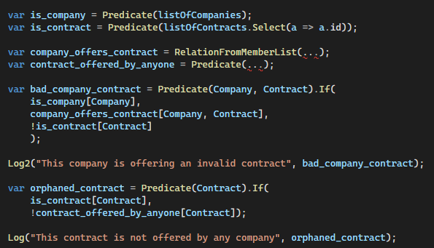
TED code
invalidCompany(C, Id) ⇐ isCompany(C) ∧ offersContract(C, Id) ∧ ¬ isContract(Id)
orphanedContract(Id) ⇐ isContract(Id) ∧ ∄C: offersContract(C, Id)

Slide 56
TED code
Each predicate can test a specific value, or generate all matching values
Here is_contract[] tests a specific value of variable Contract
Here is_contract[] produces all possible values for Contract

Slide 57
TELL vs TED
Different execution strategies!
TELL
Like Prolog, execute queries top-down, depth-first search
TED
Like Datalog, execute queries bottom-up, creating a table for each predicate or expression, and merging them

Slide 58
Takeaways
Very early in development, but:
Embedding inside C# is very, very, very nice
No longer purely stack-allocated, but that’s okay
Both systems in active development: - Optimizations coming - TED should be easy to parallelize

Slide 59
LP systems we used
System | Embedded language | Search | Type | Memory allocation
Unity Prolog | No | Top-down | ISO Prolog | Dynamic
BotL | No | Top-down | Prolog-like | Stack-based
TELL | Yes | Top-down | Prolog-like | Dynamic
TED | Yes | Bottom-up | Datalog-like Parallelizable | Dynamic

Slide 60
One more thing… NPC procgen!

Slide 61
Two use cases
1. NPC personality traits
(City of Gangsters, future game)
2. NPC composite portraits
(future game)

Slide 62
Two use cases
1. NPC personality traits
Pick 3 traits that together satisfy design constraints:
$$loner→¬ sociable∧quiet \\ quiet→¬ talkative \\ talkative→¬ quiet∧friendly \\ agile→¬ clumsy∧¬ lazy$$ $$…etc.$$

Slide 63
Two use cases
1. NPC personality traits
2. NPC composite portraits
Pick 1 body, head, hair, etc. that satisfy art constraints:
$$male↔{head}_{1}∨… ∨{head}_{M} \\ male↔{body}_{1}∨… ∨{body}_{N} \\ {body}_{5}↔{head}_{4}∨{head}_{6} \\ head_{3}∨head_{4}→{hair}_{8}∨{hair}_{9}∨{hair}_{10} \\ hair_{8}→¬ head_{10}$$
$$…etc.$$

Slide 64
Approach
It’s a satisfiability problem!
Find a model (set of true values) that satisfies all those constraints
SAT solvers exist…

Slide 65
Approach
CatSAT
It’s a satisfiability problem!
Find a model (set of true values) that satisfies all those constraints
SAT solvers exist…
SAT solver with randomization
Better randomization of solutions than traditional SAT solvers
Randomization is key for PCG!
Implemented in C#

Slide 66
Experimental systems PCG for non-programmers, creative writers, and tabletop GMs
Notes:
I think that before these kinds of systems can have real impact
The have to be usable without going to grad school
So I’ve been particularly interested in making PCG tools for non-programmers
And especially for table-top role-playing,
which I think is under-explored in PCG research

Slide 67
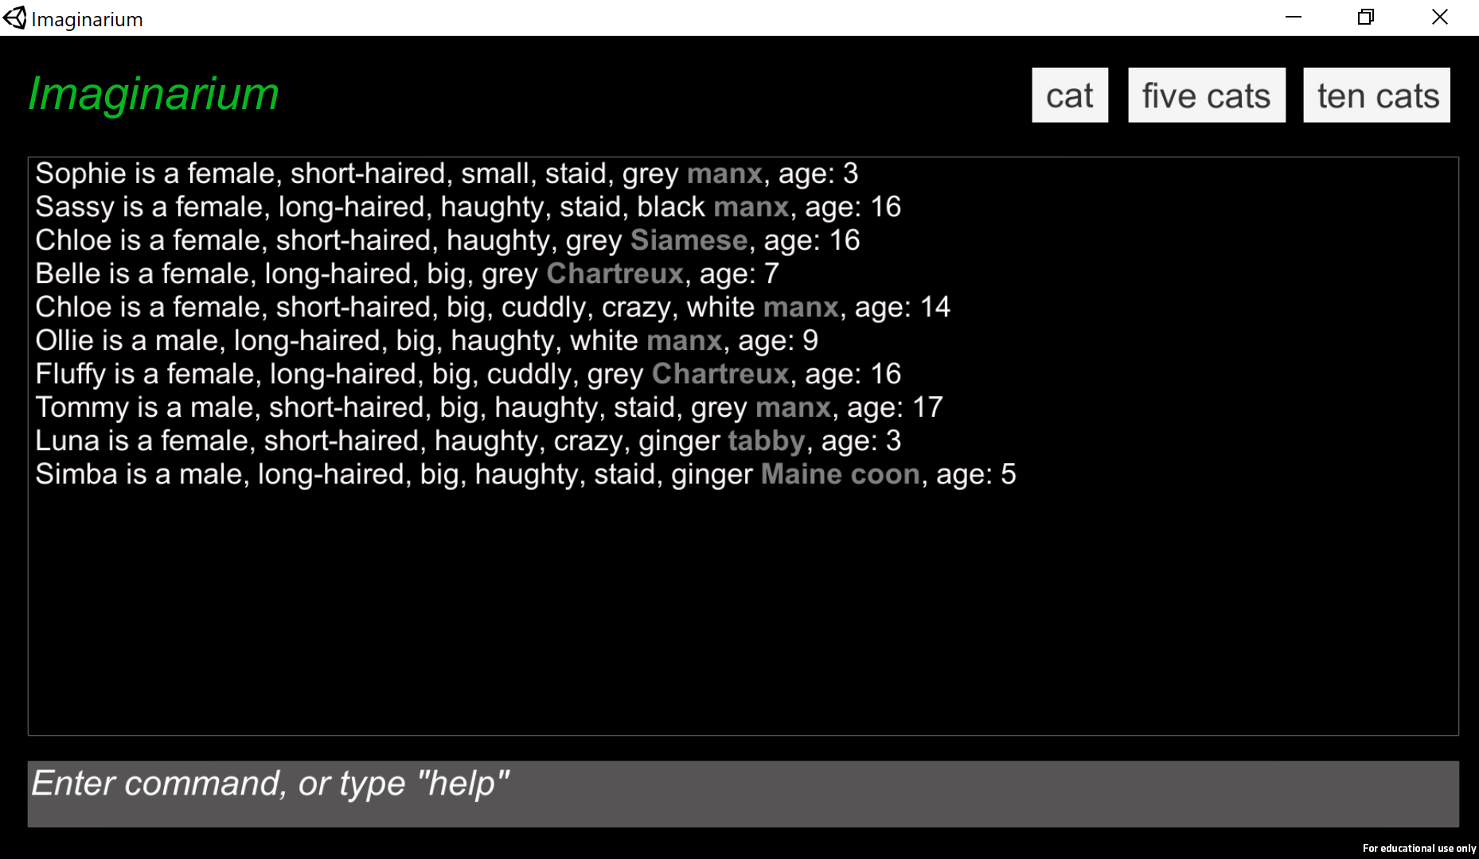
Imaginarium Constraint-based PCG from English-language descriptions
Persian, tabby, Siamese, manx, Chartreux, and Maine coon are kinds of cat.
Cats are long-haired or short-haired.
Cats can be big or small.
Chartreux are grey.
Siamese are grey.
Persians are long-haired.
Siamese are short-haired.
Maine coons are large.
Cats are black, white, grey, or ginger.
…
imagine 10 cats
Notes:
The first is Imaginarium
Which lets you use the CatSAT constraint solver Rob used
But program it in a subset of English
So you give it a bunch of statements about cats
And it can generate random cats
that satisfy the constraints you specified

Slide 68
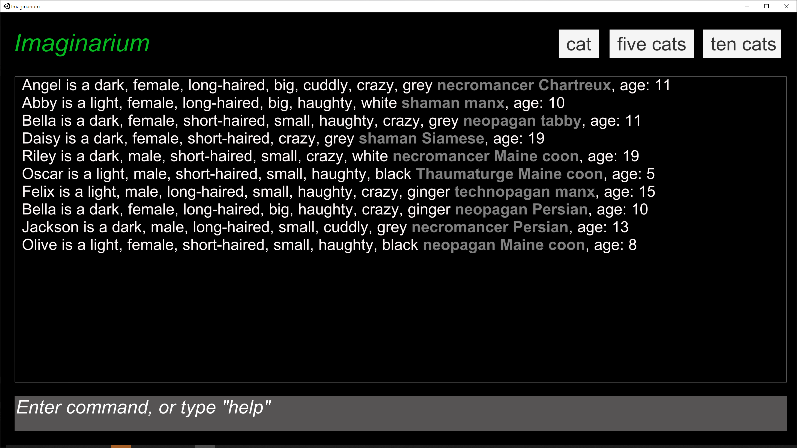
Imaginarium Constraint-based PCG from English-language descriptions
Thaumaturge, necromancer, neopagan, technopagan, and shaman are kinds of magic user.
A magic user is dark or light
Necromancers are dark Thaumaturges are light
imagine 10 magic user cats
Notes:
Give it statements about magic users
And it can generate random magic users
More importantly, it can generate random magic user cats

Slide 69
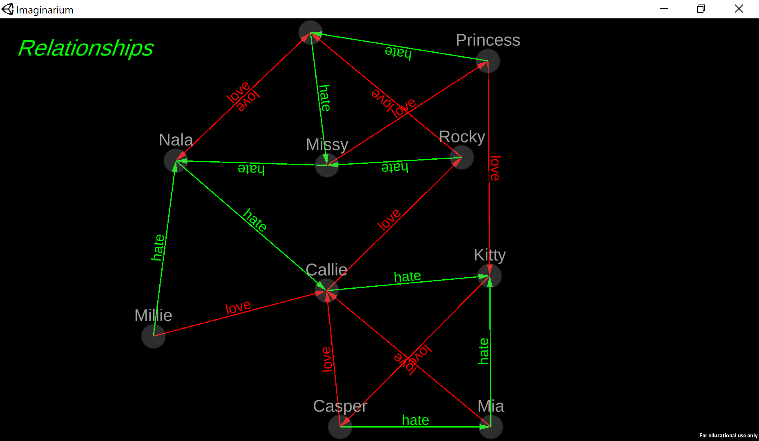
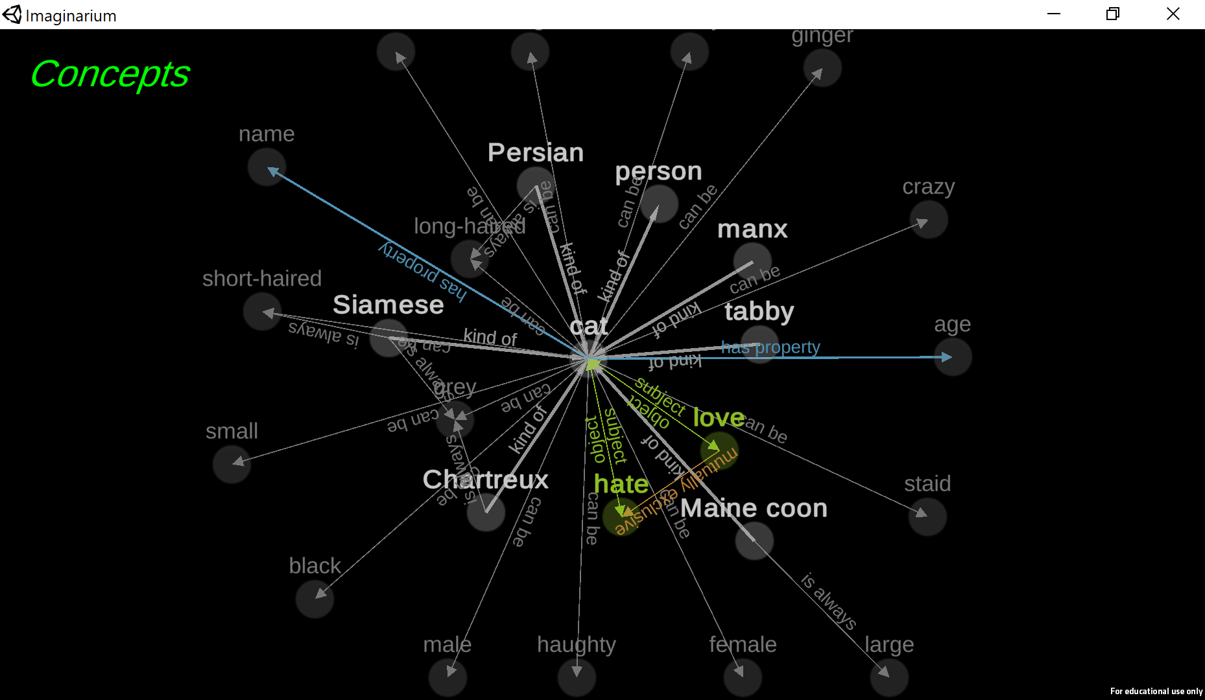
Imaginarium Generating and visualizing relationships
Notes:
It can also generate relations between characters or other generated objects
And visualize them

Slide 70
Generative text for TTRPGs (Joint work with Olivia Hill and Filamena Young)
You are hired by a curious party to take out a werewolf. The client just really hates werewolves.
When you finally find the werewolf, the area is swarming with cops. And they turn out to be extremely attractive. What will you do?
Afterward, the client has another job for you, a really hard one, and they want you to start right now.
Notes:
And recently I’ve been very interested in using logic programming to generate text.
I’m collaborating with Olivia Hill and Filamena Young
On a companion app for their commercial TTRPG, iHunt: Killing Monsters in the Gig Economy
that generates descriptions of NPCs and quests,
Based on deep knowledge of the structure of the story world

Slide 71
Summary
Logic programming is great for specific purposes
Focuses on query, hides execution strategy
Prolog/Datalog-likes: used as “SQL for knowledge graphs”
Satisfiability solver: used for PCG with constraints
Ergonomic implementations are key!

Slide 72
Links
All these systems are open source! (MIT license)
Go here: https://tinyurl.com/game-lp
Newer systems: TED, TELL, CatSAT
Older systems: BotL, Unity Prolog
Sample app
Also, join us on Discord! Talk about LP in games, get code feedback, and more. Link at: https://tinyurl.com/game-lp

Slide 73
Thank you!
Robert Zubek, SomaSim LLC, robert@somasim.com
Ian Horswill, Northwestern University, ian@northwestern.edu
Slides, software, and interactive demo: https://tinyurl.com/game-lp

